Slide 1
Detection of Parabolic Weld Defects from TOFD Scans
Roopsa Sen
2nd year, QEDM, Industrial Engineering
IIT Kharagpur
28 December 2021 - 4 January 2022

Slide 2
Improvements in Image Processing
Implemented Ransac Algorithm and Randomised Hough Transform to improve parabola detection
Improved detection of the less visible defects

Slide 3
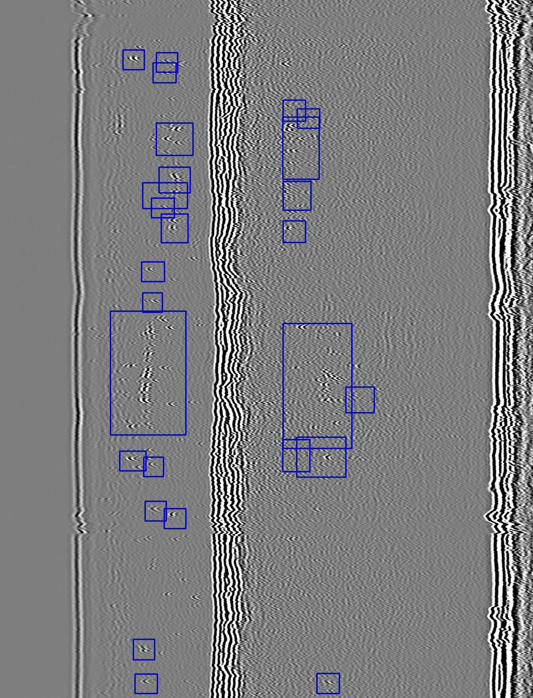
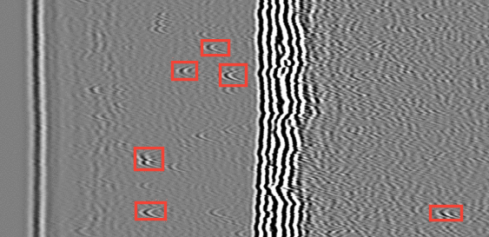
6
5
4
3
2
1
previous detection
current detection

Slide 4
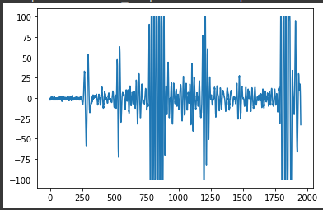
A-Scan Defect1
A-scan for entire width

Slide 5
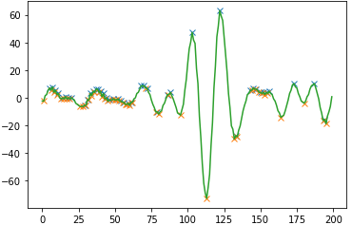
A-scan zoomed to Defect region
lateral wall
Defect 1
Detection of defect depth and lateral wall

Slide 6
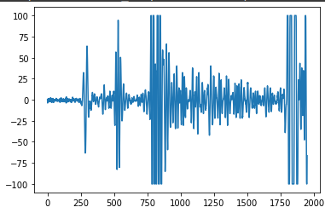
A-Scan Defect2
A-scan for entire width

Slide 7
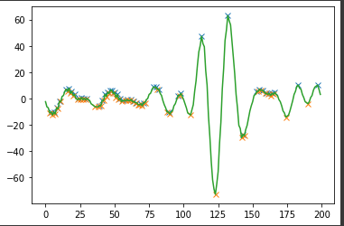
A-scan zoomed to Defect region
lateral wall
Defect 2
Detection of defect depth and lateral wall

Slide 8
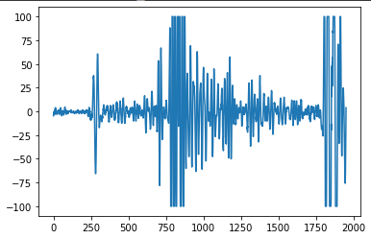
A-Scan Defect4
A-scan for entire width

Slide 9
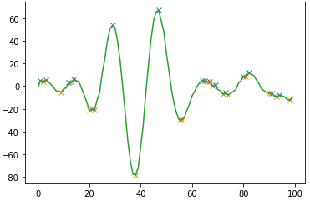
A-scan zoomed to Defect region
lateral wall
Defect 4
Detection of defect depth and lateral wall

Slide 10
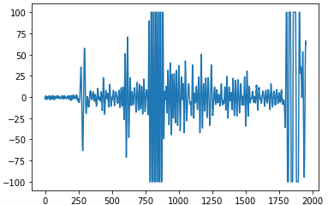
A-Scan Defect5
A-scan for entire width

Slide 11
A-scan zoomed to Defect region
lateral wall
Defect 4
Detection of defect depth and lateral wall

Slide 12
Results
Defect | Depth from LW | Height | Width
1 | 244 | 26 | -
2 | 240 | 24 | 10
3 | 240 | 22 | 10
4 | 495 | 25 | -
5 | 326 | 26 | -
6 | 379 | 24 | -

